Slide 1
LECTURE : 18B11CS311PML02
PROGRAMME : B.Tech.
COURSE TITLE : Computer Network and IoT
LECTURE TITLE : Network Models, Protocol and their Services
FACULTY NAME : Mr. Pankaj Mishra

Slide 2
Network Models, Protocol and their Services
By
Mr. Pankaj Mishra Dept. of CSE & IT JIIT, NOIDA

Slide 3
Topics of Today’s Lecture
Why Layering ?
OSI Model
TCP/IP Protocol Suite Model

Slide 4
Why Layering ?
Networks are complex!
A network is a combination of hardware and software that sends dat from one location to another. The hardware consists of the physical equipment that carries signals from one point of the network to another. The software consists of instruction sets that make possible the services that we expect from a network.
many “pieces”:
hosts
routers
links of various media
applications
protocols
hardware, software

Slide 5
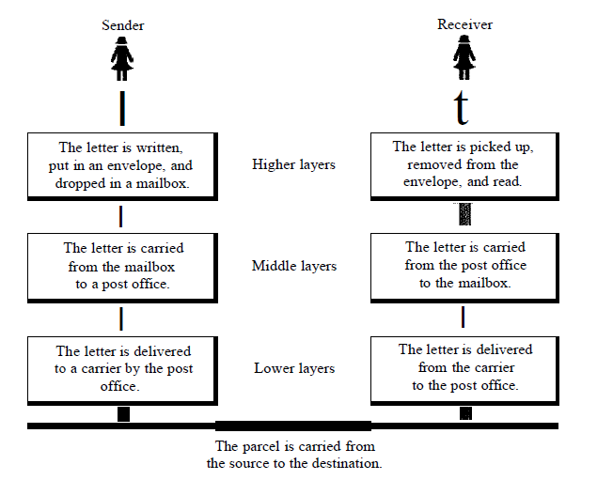
Layering of Postal Mail

Slide 6
At the Sellder Site
Let us first describe, in order, the activities that take place at the sender site.
o Higher layer. The sender writes the letter, inserts the letter in an envelope, writes the sender and receiver addresses, and drops the letter in a mailbox.
o Middle layer. The letter is picked up by a letter carrier and delivered to the post office.
o Lower layer. The letter is sorted at the post office; a carrier transports the letter.
At the Receiver Site
o Lower layer. The carrier transports the letter to the post office.
o Middle layer. The letter is sorted and delivered to the recipient's mailbox.
o Higher layer. The receiver picks up the letter, opens the envelope, and reads it.

Slide 7
Layering
Layering:-A technique to organize a network system into a succession of logically distinct entities, such that the service provided by one entity is solely based on the service provided by the previous (lower level) entity
Advantages
Modularity – protocols easier to manage and maintain
Abstract functionality –lower layers can be changed without affecting the upper layers
Reuse – upper layers can reuse the functionality provided by lower layers
Disadvantages
Information hiding – inefficient implementations
Unit-1
1-

Slide 8
Network Models/Standardized Protocol Architectures
Required for devices to communicate
Two standards:
OSI Reference model
TCP/IP protocol suite
Most widely used
Unit-1

Slide 9
OSI - The Model
Open Systems Interconnection (OSI) is a layered model
Developed by the International Organization for Standardization (ISO)
A theoretical system delivered too late! and has Seven layers
Each layer performs a subset of the required communication functions
Each layer relies on the next lower layer to perform more primitive functions
Each layer provides services to the next higher layer
Changes in one layer should not require changes in other layers
Unit-1

Slide 10
ISO OSI Reference Model
Seven layers
Lower three layers are peer-to-peer
Next four layers are end-to-end
Application
Application
Presentation
Presentation
Session
Session
Transport
Transport
Network
Network
Network
Datalink
Datalink
Datalink
Physical
Physical
Physical
Physical medium
Unit-1
1-

Slide 11
Physical
Physical interface between devices
Mechanical (joins 1 or more signal conductor, circuits)
Electrical (Representation of bits and bit rate)
Functional ( function performed by individual circuits )
Procedural (sequence of events)
Modulation and Demodulation
Raw bit stream
Modem: broadly used to refer to any module that performs the function above
Unit-1

Slide 12
Data Link Layer
Means of activating, maintaining and deactivating
a reliable link
Segmenting mechanism
Framing (Header and Trailer)
Error detection
Data synchronization( b/w transmitter and receiver)
Flow control
Error Control
Higher layers may assume error free transmission
Unit-1

Slide 13
Network Layer
Transport of information
Virtual circuit service (connection oriented)
Packet switching or datagram service (connection less)
Logical addressing (IP address)
Routing
Congestion control (flow of packet into the network)
Both connection-less and connection-oriented
Unit-1

Slide 14
Transport
Exchange of data between end systems
Error free
In sequence (segment)
No losses
No duplicates
Quality of service( Throughput, transit delay, error rate)
Unit-1

Slide 15
Session
Control of dialogues between applications/Dialogue discipline
Grouping
Synchronization/check points
Recovery
Presentation
Data formats
Architecture specific (Big-endian or Little-endian)
Provide conversion from one encoding schema to another encoding schema
Data compression
Encryption
Application
Means for applications to access OSI environment
E mail, web browsers,
Unit-1

Slide 16
TCP/IP Protocol Architecture
Developed by the US Defense Advanced Research Project Agency (DARPA) for its packet switched network Advanced Research Projects Agency Network (ARPANET)
Used by the global Internet
No official model but a working one.
Application layer
Host to host or transport layer
Internet layer
Data link / Network access layer
Physical layer
Unit-1

Slide 17
Physical Layer
Similar to OSI model physical layer
Physical interface between data transmission device (e.g. computer) and transmission medium or network
Characteristics of transmission medium
Signal levels
Data rates
Unit-1

Slide 18
Network Access/Data Link layer(1)
Data Link Control(Logical Link Control) Sub Layer
Means of activating, maintaining and deactivating
a reliable link
Framing (Header)
Error detection and control
Media Access Control (MAC) sub layer
Allocation of channel
Physical addressing (MAC address)
Higher layers do not need to know about underlying technology
Virtual point-point links between pair of stations
Unit-1

Slide 19
IP Layer
Exchange of data between end system and network
Destination address provision
Systems may be attached to different networks
Datagram
Routing functions across multiple networks
Implemented in end systems and routers
Invoking services like priority
Connection less service
Fragmentation
Routing and IP addresses
ARP and RARP
Unit-1

Slide 20
Transport Layer (TCP/UDP)
Connection-less and connection oriented service
Reliable delivery of data
Segments
Congestion control
Ordering of delivery(Reassembling)
Architecture specific (Big-endian or Little-endian)
Addressing (Port no. or SAP)
UDP (TFTP, NFS, DNS)
TCP (SMTP, HTTP, FTP)
Error Control
Unit-1

Slide 21
Application Layer
Support for user applications
File transfer
User applications
Reliable data transfer for UDP users
Network management
E.g. http, SMTP, FTP, etc.
Unit-1

Slide 22
Internet protocol stack
application: supporting network applications
FTP, SMTP, HTTP
transport: process-process data transfer
TCP, UDP
network: routing of datagrams from source to destination
IP, routing protocols
link: data transfer between neighboring network elements
PPP, Ethernet
physical: bits “on the wire”
application
transport
network
link
physical
Introduction
1-

Slide 23

Encapsulation
source
message
M
application
transport
network
link
physical
segment
H_{t}
M
H_{t}
datagram
H_{n}
H_{n}
H_{t}
M
frame
H_{l}
H_{n}
H_{t}
M
link
physical
switch
destination
H_{n}
H_{t}
M
network
link
physical
M
application
transport
network
link
physical
H_{l}
H_{n}
H_{t}
M
H_{n}
H_{t}
M
H_{t}
M
H_{n}
H_{t}
M
H_{l}
H_{n}
H_{t}
M
router
Introduction
1-

Slide 24
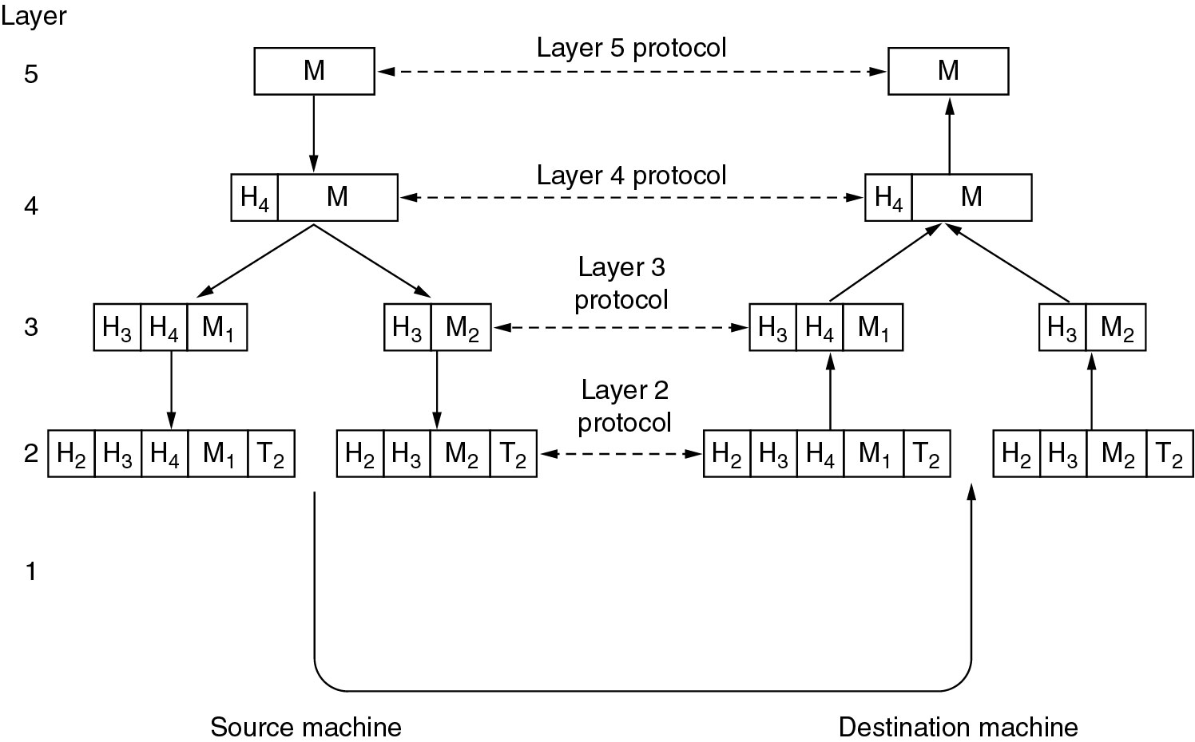
Protocol Hierarchies (2)
Example information flow supporting virtual communication in layer 5.
Unit-1

Slide 25
Thank You

